Slide 1
Our vision is to deliver best in class experience to our customers around the world
www.firstintegrated.co.uk
sales@firstintegrated.co.uk
First Integrated Solutions Ltd 01224 707585
First Integrated House, Broadfold Road, Aberdeen, UK

Slide 2
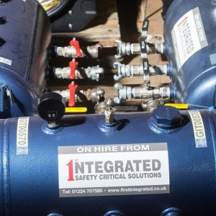
About First Integrated Solutions
First Integrated is an international provider of state of
the art lifting equipment, inspection services and equipment rental solutions, servicing clients from our UK head office in Aberdeen along with our London and Dundee premises. We also ship goods around the world.
History
The company has been in existence for 25 years and since the new shareholder invested in the business about 8 years ago the rental side of the business has grown to be a significant proportion of the business.
Services
Our integrated services are designed to improve safety, increase productivity and realise financial & operational savings for our customers. Our track record of client satisfaction is a testament to our vision and desire to become long term partners with our customers.

Slide 3
Why First Integrated
Customer Centric
At First Integrated our customers are our number 1 priority, our goal is to cater for their every need from the initial contact to delivery and beyond
Privately Owned
Our unique ownership structure gives us the capabilities to invest in the latest and most innovative products currently available
Largest & Most Modern Fleet
First Integrated currently have the largest product range in Aberdeen, and as our new partnership agreements show we are dedicated to continuing our growth strategy and extending our inventory range of equipment and services
Forefront of Technical Innovation
We are passionate about sourcing and supplying the most state of the art equipment possible to ensure our clients are constantly ahead of the curve
Short Notice Supply
Due to the fact we hold a large supply of stock we have the ability to quickly turn around orders and get them to our clients

Slide 4
What Our Customers Say
Large Subsea Service Provider “The engineers that were in working over the weekend at our base are a credit to your company”.
Tier 1 Engineering Contractor “ We would like to thank your staff for their professional approach shown during the mobilisation of our equipment, our client was very happy”.
Global Rope access Contractor “ Despite the, sometimes tight time constraints of our requests, your staff have been doing a great job of providing our orders on time, every time”.
Major Fabric Maintenance Contractor “ Please pass on our thanks to your staff for the support shown to our projects with the supply of rental equipment this year, they consistently go above and beyond to meet our clients ever demanding requirements”.
Major E&P Operator “feedback from our team offshore was this was the best rigging loft they had seen on their platform in 20 years both in terms of layout and quality of kit.”
Spirit Energy – “the quality of the equipment, documentation and service for this order was excellent please feel free to use the quote below as you would like - “The inspections have been done and passed with flying colours, the inspector said ‘This is the way it should be done’.”

Slide 5
Our Latest Products
First Integrated Solutions are continuously investing in the latest technological innovations to continue providing our customers with the strategic edge they require.
Hi-Force – The formation of this partnership delivers First Integrated as the exclusive distributor of the UK’s leading manufacturer of hydraulic lifting, torqueing and tensioning tools. This gives us the capability to provide our customers with over 2000 Hi-Force products as well as having the solid technical support of Hi-Force engineering.
Atexor – The only distributor in Aberdeen of the Atexor ATEX Lighting and spares. This allows First Integrated to provide our customers with IECEx, ATEX and UKEX lighting for Explosion Hazardous Areas. A brand recognised around the world for quality and reliability.
Night Stick – Performance, Quality and Value Nightstick, designed and manufactured by Bayco Products, Inc., is a global brand of professional lighting products including flashlights, headlamps and Intrinsically Safe lighting solutions that exceed the industry standards in performance, quality, user-safety and value.

Slide 6
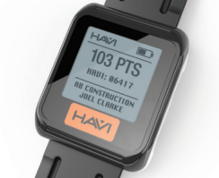
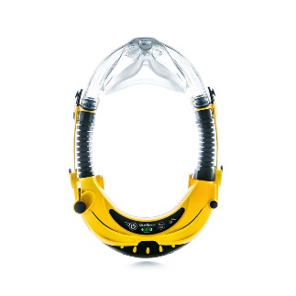
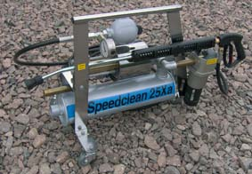
Innovative Products FIS have led to market
First Integrated Solutions with our large customer base have a proven track record of bringing innovative products to market.
HAVi – Over the last 12 years HAVi have constantly been developing our products. All this effort has culminated into the most versatile HAV Management System on the market today. HAVi products have been fully tested and proven to work across all industries.
CleanSpace - Respiratory disease affects 1 in 5 people and is the third biggest cause of death in the UK. The addition of the CleanSpace Breathing Air equipment allows First Integrated to offer the most technologically advanced powered air- purifying respirators on the market today.
Flapres – ATEX pneumatic pressure washers that are lighter compact units with comparable pressures ranges to the industry standard units already in service, this coupled with minimum maintenance required makes these units a more cost-effective alternate for FIS customers.

Slide 7
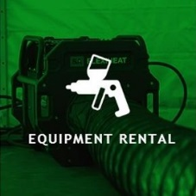
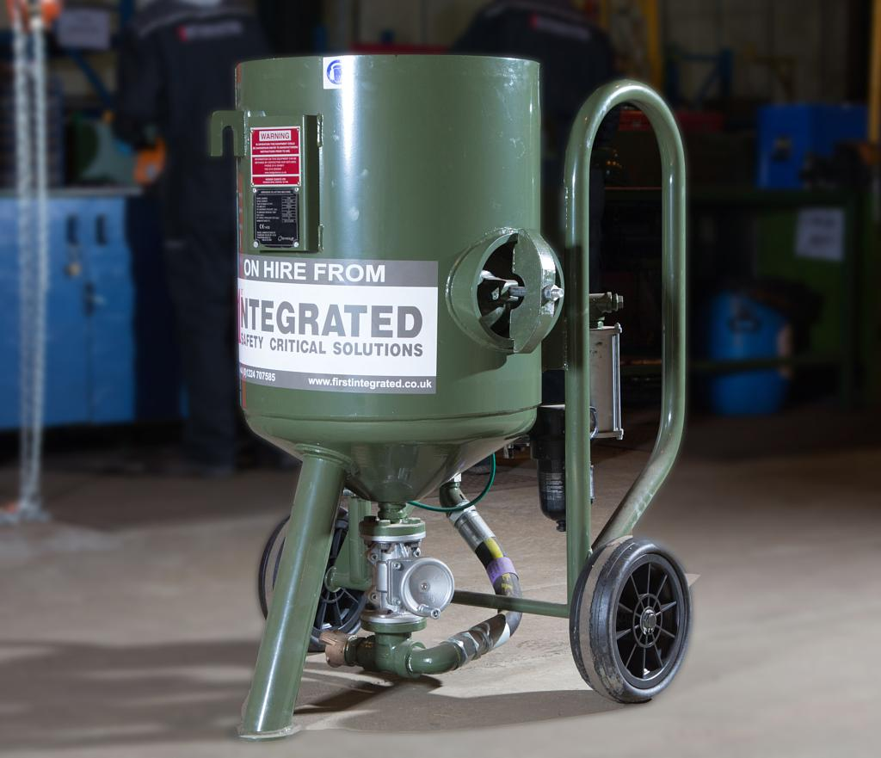
Equipment Rental - Tooling
First Integrated Solutions offers a large range of high quality tooling for rental, with products and services selected to reduce down time, increase productivity, and realise significant operational savings for our customers.
ATEX Lighting Equipment
Electric & Pneumatic Power Tools
ATEX Heating Equipment
Portable Blasting Equipment
Extraction & Ventilation Equipment
Air Distribution Equipment
Portable Painting Equipment
Breathing Air Equipment
Working at Height Equipment

Slide 8
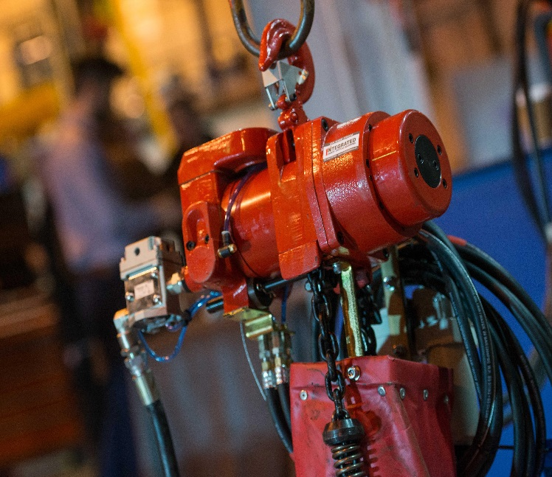
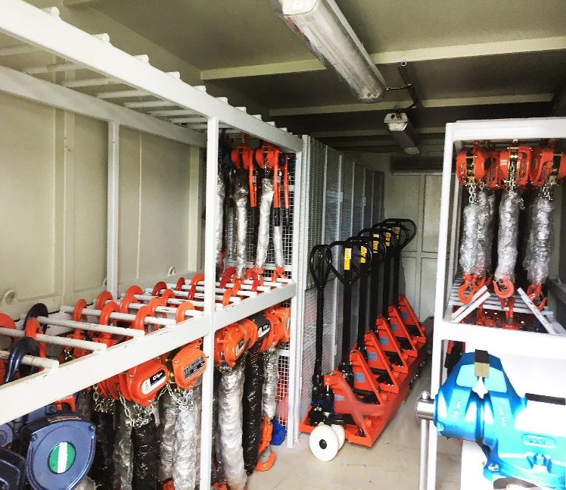
Equipment Rental - Lifting
First Integrated Solutions are capable of suppling a vast range of lifting equipment from our rental fleet, including specialised rigging lofts tailored to each customers requirements, manual and pneumatic hoists, chain systems, spreader beams, fall arrest equipment, shackles and other items of loose lifting gear.
Rigging Lofts
Shackles
Associated Rigging
Air Hoists
Eye Bolts & Swivel Hoist Rings
Beam Clamps
Chain Blocks & Lever Hoists
Webbing Slings & Round Slings
Modulift Spreader Beams

Slide 9
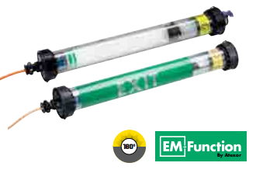
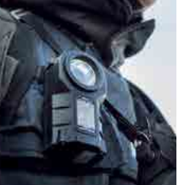
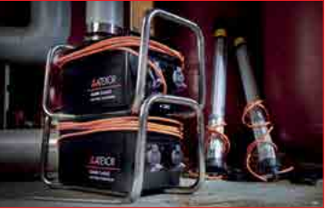
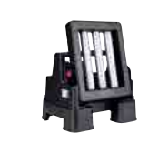
Equipment Rental – ATEX Portable Lighting
First Integrated Solutions have formed a revolutionary new partnership with Atexor, the the world’s leading innovator and manufacturer of portable IECEex and ATEX lighting for hazardous areas.This sees First Integrated as the exclusive distributor in Scotland for the range of Atexor products and in house sales and servicing expertise.
Linkable Lights
Emergency Linkable Lights
Tank Entry Lighting Systems
Transformers
Floodlights
Inspection Lamps
Torches
Splitter Boxes and associated cables

Slide 10
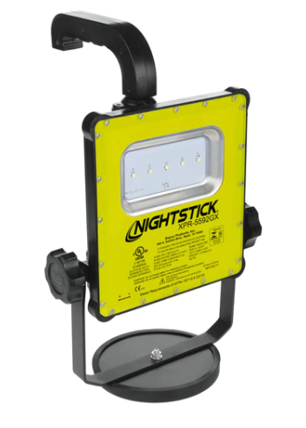
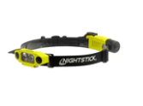
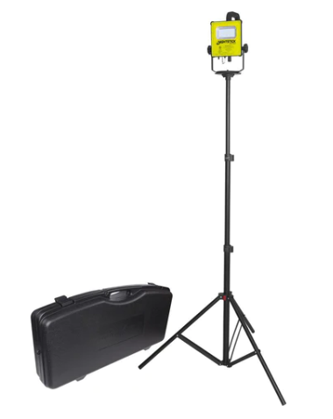
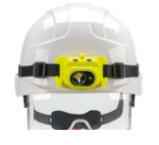
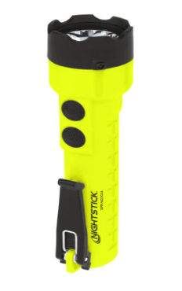
Equipment Rental – IS Portable Lighting
First Integrated Solutions have formed a new partnership with Nightstick, headquartered in North America and designed and manufactured by Bayco Products, Inc. which is a global brand of professional lighting products including flashlights, headlamps and Intrinsically Safe lighting solutions that exceed industry standards in performance, quality, user-safety and value.
(Zone 0) IS Rechargeable Scene Lights
(Zone 0) IS Rechargeable Scene Light Kits
(Zone 0) IS Rechargeable Head Torches
(Zone 0) IS Head Torches
(Zone 0 ) IS Torches

Slide 11
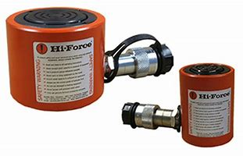
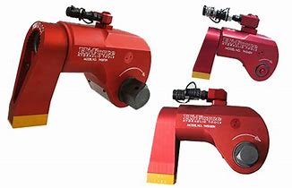
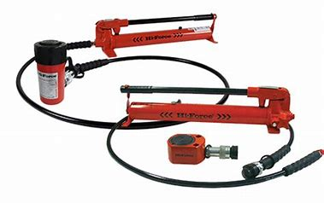
Equipment Rental - Hydraulic Equipment
First Integrated Solutions have formed an exciting distribution partnership with Hi-Force, the UK’s leading manufacturer of hydraulic tools. This sees First Integrated as the exclusive distributor in the North of Scotland for the range of Hi-Force products and in house sales expertise.
Cylinders
Pumps
Jacks
Torque Tools
Bolt Tensioners
Hydrotest Pumps Puller Kits
Crimpers & Cutters
Tools
System Components

Slide 12
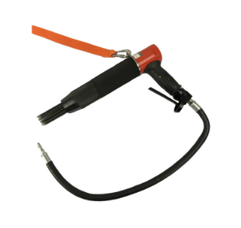
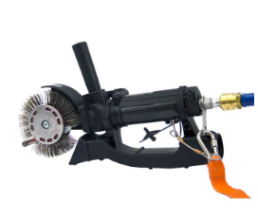
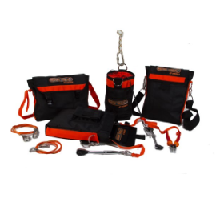
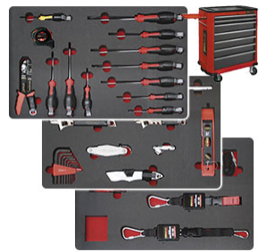
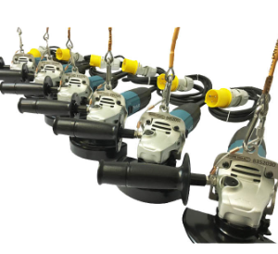
Equipment Rental – Working at Height
First Integrated Solutions are proud to offer a cost-effective rental solution to operate tools at height reducing the capital expense to the business and providing traceable, practical, and safe working at height industry solutions serving the Oil & Gas, Renewable, Utilities and Infrastructure sectors.
Surface Preparation Tools
Pneumatic Tools
Electrical Tools
Battery Operated Tools
Secondary Retention Products
Tethered Tooling Solutions
Harnesses and Accessories

Slide 13
Equipment Rental - Welding Equipment
First Integrated Solutions have formed an exciting distribution partnership with Newarc to supply a full range of welding equipment and ancillary consumables. This service includes our ability to provide bespoke welding packages to suit all your project needs.
MMA
Tig
MIG
Plasma Cutters
Diesel Welders
AC/DC Tig
Air Arc Gouging Straight Line Cutters / Pipe Cutters
Ancillary Consumables

Slide 14
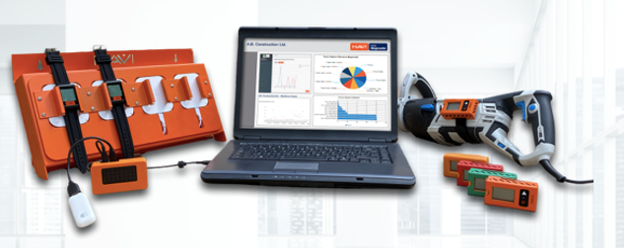
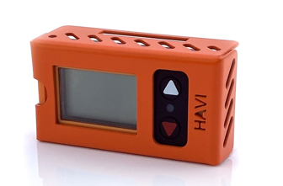
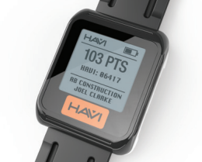
Equipment Rental – ATEX HAVi
First Integrated Solutions have formed an exclusive distribution partnership with HAVi Technologies the worlds leading specialist in the supply of solutions to help organisation's tackle Hand Arm Vibration Syndrome(HAVS).
ATEX Smart Watch
ATEX trigger timers
Cloud based software
Onsite HAVS analysis
IOSH HAVS Training
Site Compliance Audits
Site Installation Services
Risk Assessments
Positive Procurement Services

Slide 15
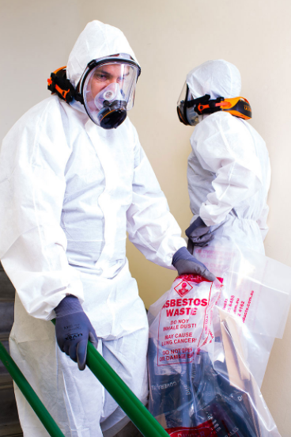
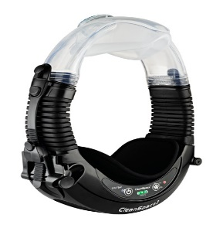
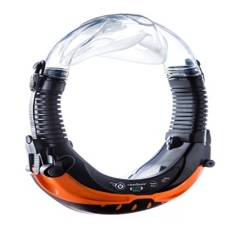
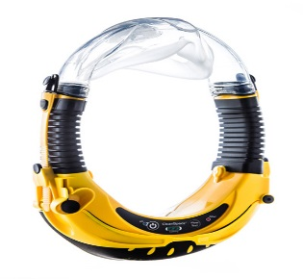
CleanSpace Respirators
Established in 2009 by a world class medical device engineering team with a vision to make respiratory protection wearable and easy to use. Designed and built with the same rigour as in the medical industry, CleanSpace respirators are safe and reliable.
CleanSpace2 – P2/P3 &TM3 certified PAPR
Lightweight 500g and compact
Fresh clean air for up to 8hrs
No Servicing or maintenance
Filter & Battery alarms
CleanSpace Ultra – P2/P3 &TM3 certified PAPR
IP66 rated
Lightweight 500g and compact
Fresh clean air for up to 8hrs
No Servicing or maintenance
Filter & Battery alarms
CleanSpace EX – P2/P3 &TMS3 certified
Intrinsically safe
IP66 rated
Lightweight 500g and compact
Fresh clean air for up to 8hrs
No Servicing or maintenance
Filter & Battery alarms

Slide 16
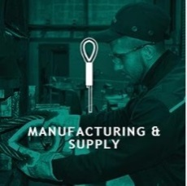
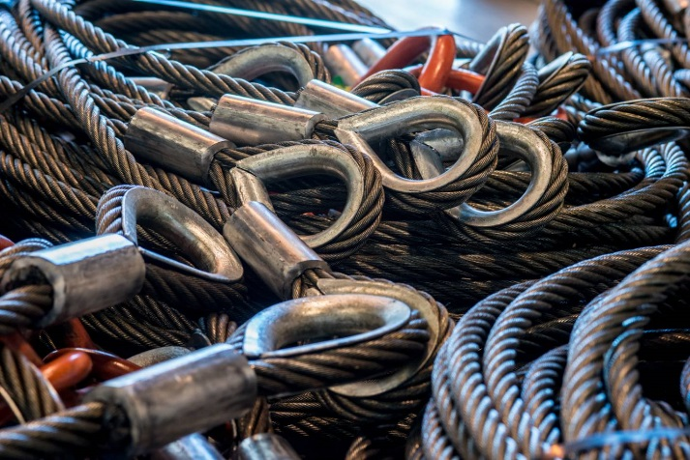
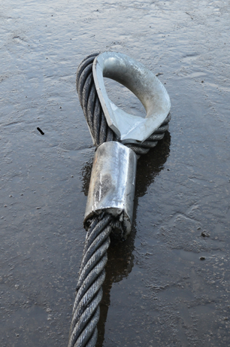
Manufacturing & Supply – Wire Rope Slings
First Integrated Solutions offer a wide range of wire rope & wire rope related products and services. With modern and fully equipped wire rope sling manufacturing facilities in both the United Kingdom and Trinidad we can manufacture and supply these products and services to the highest standard.
Capacity to manufacture wire rope slings with pressed end terminations from 3mm up to 128mm in diameter. We also offer larger diameter ropes with alternative termination options.
Wire rope slings in full compliance with the BSEN13414 standard.
External accreditation to DNVGL 2.7-1, DNVGL 2.7-3, IS2762 & NORSOK 002
Ability to provide wire rope slings in various configurations including,
Single leg
Double leg
Multi leg with or without forerunners
Aluminium ferrule with or without thimbles
Flemish steel sleeve with or without thimbles
Various types of resin poured sockets

Slide 17
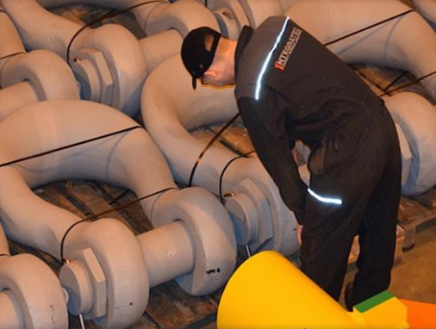
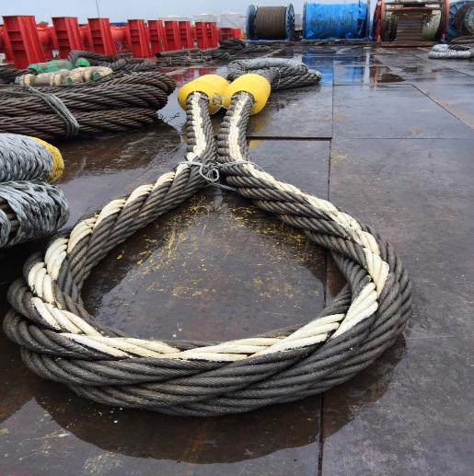
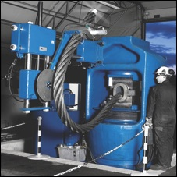
Manufacturing & Supply – Heavy Lifting
First Integrated Solutions can manufacture, supply, store and inspect a wide range of heavy lift rigging. These diverse range of products and services allows us to support our customers with all their heavy lift projects. From renewables to decommissioning our customers can be assured we have the experience and technical expertise to support their requirements.
Ability to provide a wide range of products including,
Large diameter wire rope, loads of 77mm and 64mm in stock in particular
Sockets
Grommets
Shackles
Mater links
Synthetic slings
Spreader beams
Spooling services
First Integrated also store, manage and re certify customers owned heavy lift rigging equipment to facilitate a cost effective option for re-use.

Slide 18
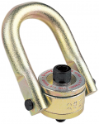
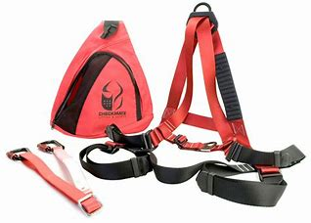
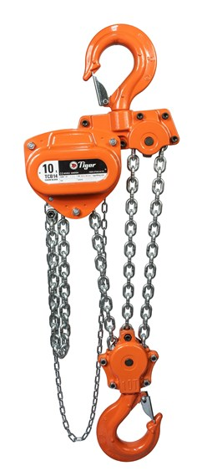
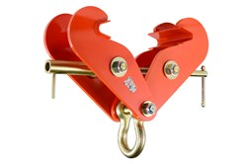
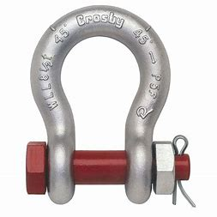
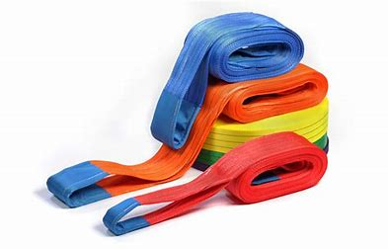
Manufacturing & Supply – Lifting Equipment Supply
First Integrated Solutions offer a wide range of lifting equipment for purchase. Holding distribution deals with the worlds leading manufacturers allows us to offer only products of the highest quality with full certification and tractability.
Webbing & Round Slings
Chain Slings & Assemblies
Shackles
Links
Swivel Hoist Rings
Modular Spreader Beams & Frames
Fall Arrest Equipment
Manual, Pneumatic and Electric Hoists
Hooks
Sockets
Lifting Eyes
Clamps
Sheave Blocks
Plus Many Other Rigging Accessories

Slide 19
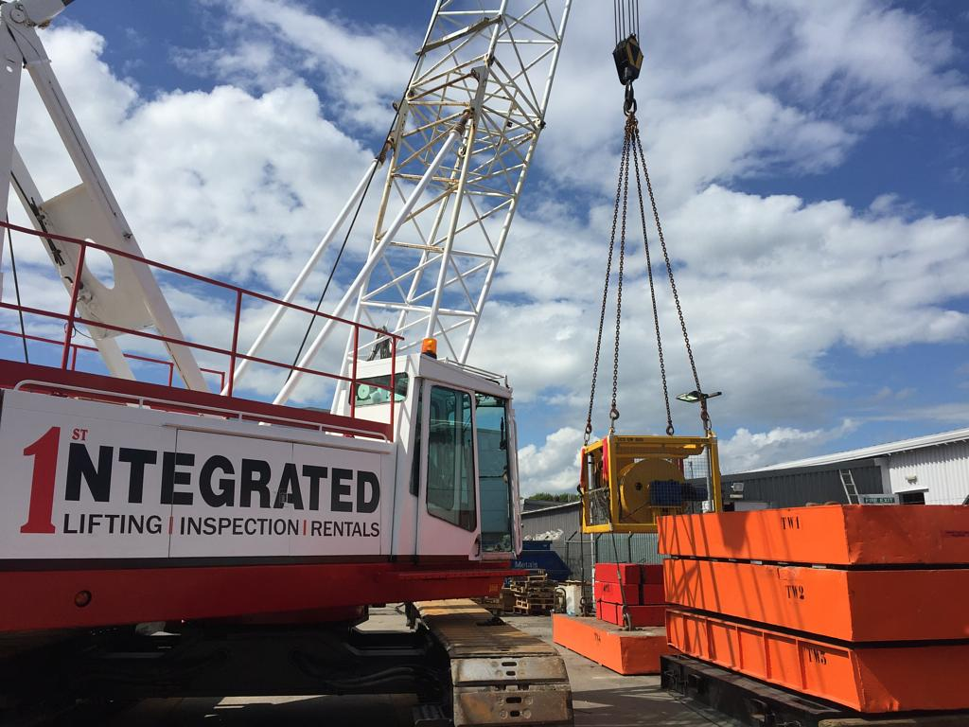
Inspection Services
First Integrated Solutions are a leading provider of a range of inspection services.
Offering an unrivalled quality service thanks to our multi-disciplined engineers, technical support team and our ability to find the optimum solution to meet our customers needs.
P.A.T. testing and inspection
HAVS analysis of portable tools and appliances
Technical Authorities, ICPs and lift planning
Lifting equipment inspections in compliance with LOLER
Onsite/Offshore inspections
In house refurbishment and test/inspections
Specialist wire rope NDT inspections
Training services tailored to our customers requirements
Load testing Facilities
200t horizontal tensile test bed
60t fixed boom crane
Various test weights, water bags, load cells

Slide 20
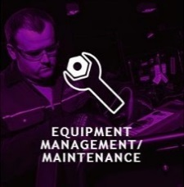
Equipment Maintenance & Management
Rental Asset Management Software
Our advanced hire system accurately tracks all our hire assets to ensure we can provide our clients with portal access to all equipment currently on hire to them
Additionally, we can generate an instant report showing rental history, current deployment & maintenance status of all FIS equipment
Cloud Documentation
Our cloud storage platform allows our clients to gain immediate access to any documents required for example reports of thorough examination, etc.
Clients simply login through our website to access their certification
Equipment Servicing, Refurbishment & Repair
FIS maintain, service and repair a wide range of lifting equipment ranging from mechanical equipment to wire rope slings
We are also one of few Ridge gear service centres, allowing us to service Ridgegear equipment in-house
Asset Management, Monitoring, Control & Measurement
We offer storage & warehouse services to our clients, as well as reports to identify the location & status of equipment
FIS are constantly keeping abreast of technological advances & changes in relevant legislation to ensure our clients equipment is compliant

Slide 21
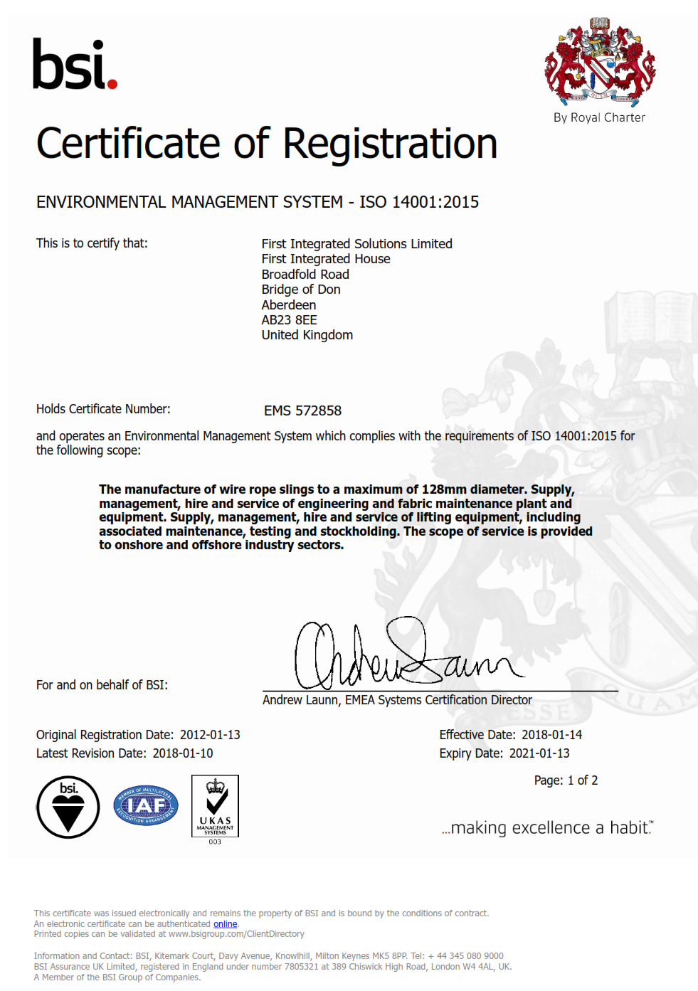
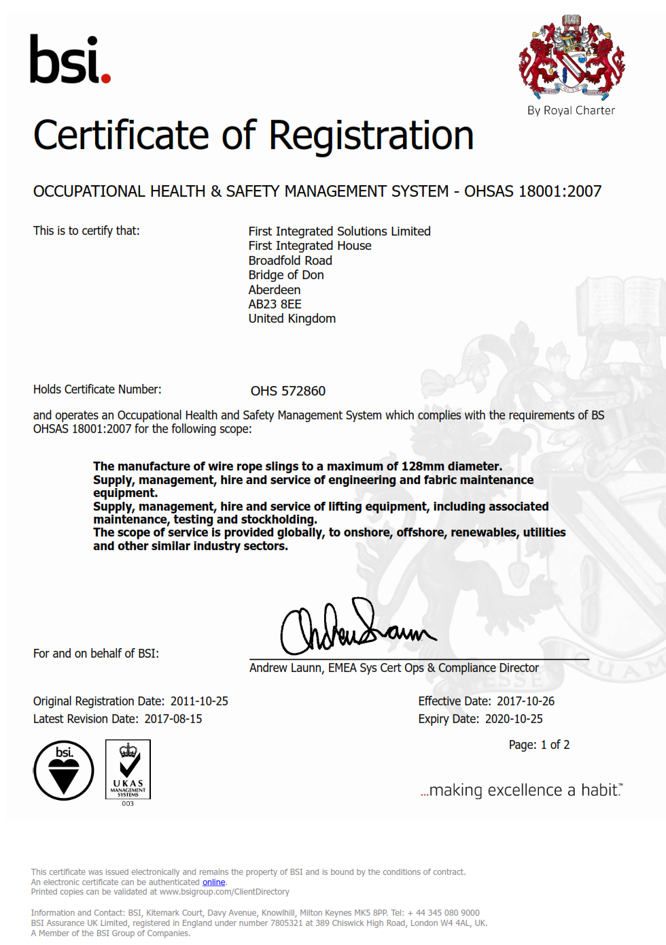
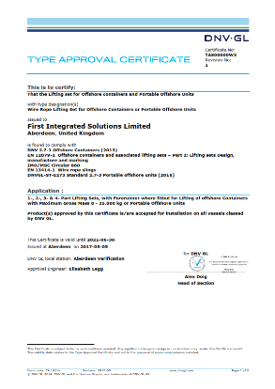
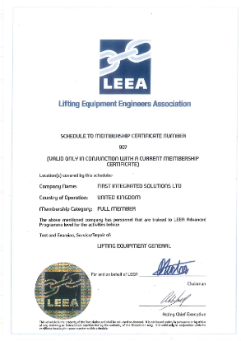
Accreditation
ISO Certification Certified by BSI to,
9001:2015 Quality Management
14001:2015 Environment Management
OHSAS 45001:2018 Occupational Health & Safety
Manufacturing
Type Approved by DNVGL 2.7-1, DNVGL 2.7-3 & EN12079-2
Full and active members of LEEA (Lifting Equipment Engineers Association)
Members of the British Safety Council
Members of the International Association of Drilling Contract
Supply Chain Validation
FPAL registered – Achilles
SEQual

Slide 22
Suppliers
First Integrated Solutions only work with top quality manufacturers and suppliers to ensure our customers get the highest quality and technically innovative products.
Our value of being the best customer led organisation ensures we are constantly investing in new products and making new partnerships to constantly have the best and most comprehensive possible product range available for our customers.

Slide 23
Patented Ballgrab (ball and taper) technology Subsea Mooring Connectors Pipeline Recovery Tools Bend Stiffener Connectors Cable Protection Systems Caisson and Conductor Recovery Many other decommissioning applications Heavy lift applications
Provides a comprehensive range of lifting equipment including being one of the largest manufacturers of wire rope slings in the UK
Also provides associated inspection services
Wide range of equipment rental products:
Portable painting & blasting equipment, ATEX heating and lighting products, range of power tools, Air hoists, winches and spoolers and many more
HAVS Management services
Provides Mooring Equipment and expertise, Oil and Gas and Floating Wind
One of the largest and most modern equipment fleets in UK
Full Rig Moving Service in house
Offers competitive Pricing Worldwide
Quayside indoor and outdoor facility at Montrose
Patented Tri-Catenary Mooring System technology (TCMS)
Advantages:
Much less intrusive to vessel than turret mooring system
Weather vanes so easier to offload vessels
Much cheaper than alternate systems
Ideal for marginal fields or extended well tests
Partners with Manuli hose
In stock: a quick connect disconnect unit and Pusnes for EWT
400t Carousel
Range of Spoolers
Experience team providing the following lifting products and services, internationally:
Desktop and Compliance, Compliance Reviews
Policies, Processes and Procedures
Technical Support
Training & Assessment
Lifting Personnel
Safety Awareness Handbooks
Analytics

Slide 24
Contact First Integrated Solutions
Dundee
First Integrated Solutions
Port of Dundee,
Fish Dock Road
Stannergate
Dundee
DD1 3LZ
Mobile: +44 (0) 7717667014
Tobbe.Stenberg@firstintegrated.co.uk
London
First Integrated Solutions
Unit 2 Lamb's Business Park, Terracotta Road, Tilburstow Hill Road, South Godstone, Surrey,
RH9 8LJ
Main: +44 (0)1883 338551
Mobile: +44 (0) 7717667014
trevor.hollyoak@firstintegrated.co.uk
Aberdeen
First Integrated Solutions Ltd
First Integrated House
Broadfold Road
Bridge of Don
Aberdeen
Scotland
AB23 8EE
Main: +44 (0) 1224 707585
sales@firstintegrated.co.uk

